Slide 1
第二章 宽禁带半导体材料制备（第4－6次课）
§2.1主要制备技术 §2.2 MOCVD原理
§2.3 InGaN，AlGaN热力学模拟
§2.4 GaN基材料生长工艺
§2.5 PSS与NPSS外延 §2.6 Si上GaN生长
§2.7 低维结构外延 §2.8 本章小结

Slide 2
2.2 MOCVD原理
2.2.1 MOCVD生长的关键过程
2.2.2 MOCVD生长的步骤
2.2.3 MOCVD 生长系统

Slide 3
2.2.1 MOCVD生长的关键过程
热力学
外延驱动力
最大混合生长速率
Stoichiometry和掺杂剂结合
合金的固体组分
表面重构
质量和热量输运
流体力学⎯界面外延层,回流气流,“死”区
接近热衬底表面的温度分布
质量输运过程及速率─ 扩散与对流

Slide 4
MOVPE生长的GaN中背景载流子浓度和缺陷的关系
热平衡的方法用来计算理想GaN晶体中背景载流子浓度和缺陷的关系。
在800K到1500K的温度范围内，N空位浓度的计算结果不超过2×10¹⁷ cm⁻³ 。
也就是说， N空位在载流子浓度低于2× 10¹⁷ cm⁻³时， 可能是主要的因素，但是对于载流子浓度大于2× 10¹⁷ cm⁻³时，主要的源应该不是N空位。
这个结论为进一步改善GaN晶体质量提供了方向。
Applied Physics Letters 71(23):3376-3378，（1997）

Slide 5
vacancies and antisites are dominant defects at growth temperature. The reactions are as follows
Ga_{g} = Ga_{Ga} + V_{N}* ------------(1)
N _{g} = N _{N} + V_{Ga}* ------------(2)
V_{N}* =V_{N} ⁺ + e - ------------(3)
V_{Ga}* =V_{Ga} ⁻ + h+ -----------(4)
Ga_{g} = Ga_{N}²⁻ + V_{Ga}* + 2h+ -----------(5)
N _{g} = N _{Ga}²⁺ + V_{N}* + 2e - -----------(6)
V表示空位，下标g，Ga，N分别表示气相，Ga格位和N格位。上标+，—和*分别表示正电荷、负电荷和电中性。e-和h+分别代表电子和空穴。

Slide 6
the condition for the charge neutrality and the relation
pn = n_{i}² = 4 (2πkT/ h²)³ ( m_{e}*m_{v}* )^{3/2} exp( -ΔE_{cv}/ kT)
----------(7)
equilibrium constant K_{i} of each of the reactions of equations (1) to (6),
Ki = exp(- ΔG/kT), ΔG= Δ H_{i} - T Δ S_{i}
K_{i} = exp[ -(Δ H_{i} - T Δ S_{i} ) /kT ] ------------ (8)
Δ Ecv(T) = Δ Ecv(0) - aT² /( T + b ), ----------- (9)
the changes of enthalpy (ΔHi) and entropy (ΔSi) can be deduced from the formation enthalpy and the entropy variations of reactions

Slide 8
随着Ga分压的增加或N分压的降低，N空位浓度增加。
但是这种随着N分压的改变非常缓慢，要想得到10¹⁹ cm⁻³ 的N空位浓度， (p_{N} / p_{Total}) 值达到10⁻²⁰ ， (p_{Ga} / p_{Total}) 约为1。
这表明在通常的N分压下，对于n>2*10¹⁷ cm⁻³,的载流子浓度，N空位不是主要的原因。
作为比较，我们还在550°C下生长了GaN薄膜3个小时，厚度约为2微米，载流子浓度大于10¹⁹ cm⁻³.
在这样的温度下，没有发现N和Ga分压对载流子浓度的影响。这表明低温生长不能降低背景载流子浓度。

Slide 9
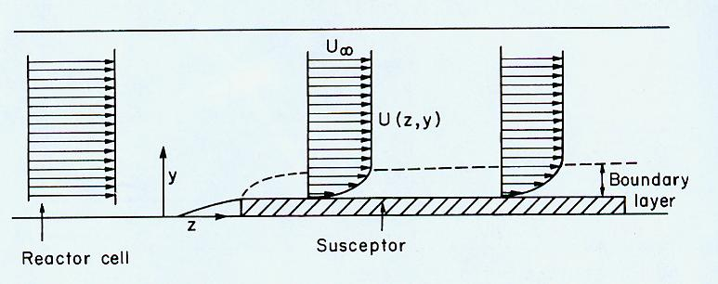
2.质量输运（流体力学）
OMVPE的流体力学问题是整个OMVPE过程的最基础的部分。
OMVPE的流体力学问题对反应室构造和系统总压力有更密切的依赖关系。
对于所有常规OMVPE过程而言，当超过衬底温度的适当范围时，流体力学效应将限制生长速率。
OMVPE流体力学问题的完全处理包括三维的质量（源）、动量、及能量在适当边界条件下偏微分方程系列的联立解。
基座上方边界层平行束流的变化

Slide 10
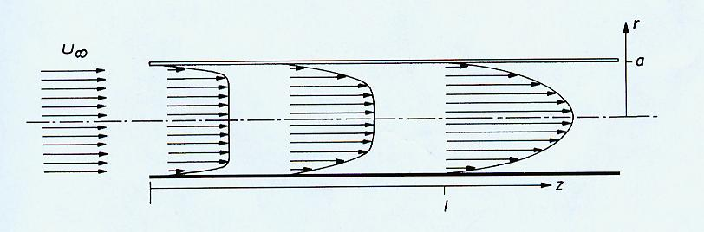
卧式反应室中束流的变化——束流速率达到不变的、抛物线分布曲线。这是假定Reynolds数足够低以提供层流的条件下成立。
实际OMVPE反应室中，舟被加热而管壁是冷的。当加热的气体在冷气之下，存在自然对流的驱动力。 Reynolds数高则会发生对流。
入口效应：小直径入口管（mm）必须被适当地与反应腔（几十cm）相连，反应腔有一个大得多的横截面。即使当反应管这两部分用适当的锥形区连接，角度低于7°，喷流仍会发生。提供一高速“指状”区 延伸进反应腔一段相当大的距离，或许甚至达到舟上，可以减少喷流。

Slide 11
边界层模型
质量输运限制机制中计算生长速率的最广泛应用的模型是边界层模型。在外延界面上方存在一个真实的停滞层，穿过此层质量輸运仅仅通过扩散(mm-cm)。
沿束流方向界面层厚度逐步增加，浓度分布曲线也沿生长方向逐步展开。
将生长的衬底倾斜放置，补偿气相损耗的影响，也补偿沿束流方向的界面层厚度的逐步增加。这种由于舟倾斜引起的束流速度的增加对于前缘下游位置来说将导致界面层厚度的减少。依次导致生长速率增长，取一个恰当角度恰好补偿了反应物分压的降低。

Slide 12
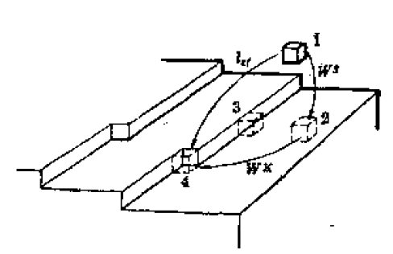
3.表面过程
台阶面上不同位置的吸附分子。最近邻分子的交互作用能为2Φ1，次近邻为2Φ2，则当流体分子进入位置（2），系统释放能量为：
W=2 Φ1+8 Φ2
进入位置（3），
W=4 Φ1+12 Φ2
进入位置（4）， W=6 Φ1+12 Φ2。晶体生长的几种途径：
流体分子（1）——吸附分子（2）——台阶分子（3）——扭折分子（4）
流体分子（1）——吸附分子（2）——扭折分子（4）
流体分子（1）——扭折分子（4）
B/C是指台阶面比较窄（几个原子间距），吸附分子很容易达到台阶或扭折处。

Slide 13
面扩散：吸附分子在热激活下向最近邻的晶格位置移动所需克服势能较低。扩散的激活能与键能大小，晶体结构以及晶面相关。
面扩散还与分子水平振动频率成正比。
脱附：是指吸附分子离开界面。相变潜热越大，分子越难以脱附，其面扩散定向迁移也越大。
当原子台阶扫过整个台阶面后，台阶面的生长即消失。
二维成核机制：在光滑的奇异面上，吸附分子通过面扩散可以集结成二维胚团。系统因胚团的出现而增加了棱边能。棱边能各向异性。对于立方晶体，二维晶核一般为正方形，六方晶体则为正六边形。随着生长温度的提高，这些晶核逐渐变成圆形。
一旦二维核形成，则进行台阶面的生长。当两次成核的时间间隔小于二维核台阶扫过晶面的时间，则为多二维核生长。相邻的台阶面相遇后湮灭并不留下痕迹，一般仍为单晶体。
单二维核的生长规律为驱动力的指数规律。指数律存在一临界饱和度，低于此值，生长速率为0，超过临界点，生长速率成指数变化。但是在过饱和度大于一定值后，生长速率不再决定于成核率，而是决定于达到二维核的分子流量（质量输运机制）。
多二维核的动力学规律也为指数律。

Slide 14
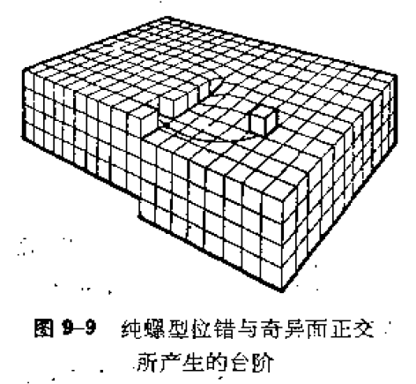
位错生长机制
光滑界面不能通过热激活产生台阶，而只能通过二维生长成核不断地产生台阶以维持晶体生长。
二维晶核的棱边能，导致生长速率与驱动力之间的指数规律。
实验上观察到即使远低于驱动力的情况下，晶体仍然以一可观测的速率生长。这表明存在某种效应，降低了二维晶核的成核势垒。
晶体中的缺陷：位错，孪晶就可以产生这种效应。
螺位错在生长过程中提供无穷尽的台阶源，这就消除了二维成核的必要性。故在远低于二维成核临界驱动力的情况下，晶体仍可以生长。这是因为螺位错使得晶体中的晶面称为螺蜷面，而非完整晶体的一层一层堆垛起来。

Slide 15
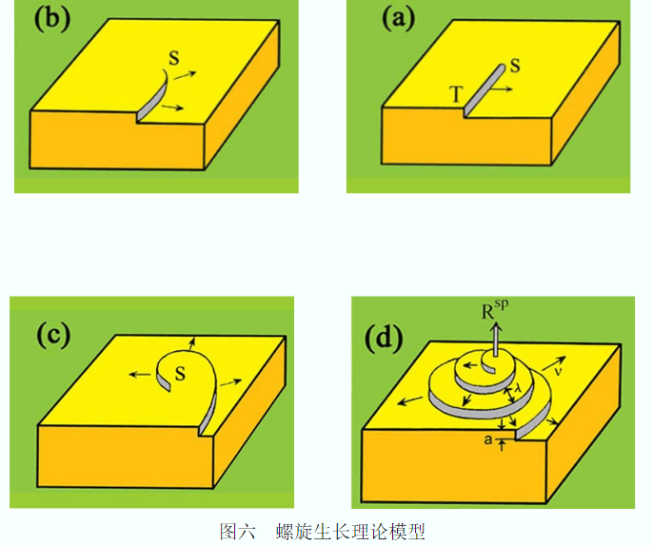
台阶的一端固定在位错的露头点，台阶运动后，在露头点附近台阶必然弯曲，越接近露头点曲率半径越小。台阶运动速率越小。在露头点，台阶运动速率为0，曲率半径为临界半径r0。随着台阶运动，就很快形成螺蜷线，越卷越紧，最后形成运动的形状——生长丘。
蒸发，溶解或熔化则为反向过程，形成蜷线状的坑。

Slide 16
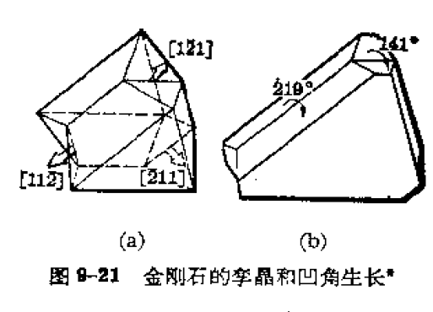
凹角生长机制：奇异面(低指数密堆面 ）的凹角处同样可以降低成核的势垒。金刚石的（111）面若为二维成核机制的生长，其速率相对较低。在天然金刚石中，存在片状生长，显露的仍为（111）面，但片状晶体中存在孪晶面。其中{1-21}面为凹面，为快速生长面。
晶面淘汰律：生长过程中快速生长的晶面将隐没，而慢速生长的晶面将显露。
多重孪晶的生长机制：第一孪晶面的凹角消失，但第二孪晶面的凹角发育变大，同样，随着生长，第二孪晶面凹角消失，第一孪晶面将发育的最大。即生长过程中两个孪晶面凹角相互制约，永不消失。
粗糙界面的生长是连续过程，界面上任何原子都具有相同的势能，晶体缺陷在生长过程中不起作用，粗糙界面的生长为法向生长。（三维生长）

Slide 17
4.化学反应
分子式一般为MR_{n}，这里M代表OMVPE所感兴趣的II，III，IV，V和VI族元素，而R被限定为甲基或乙基。当然，H配位基是V族和VI族源的最普通的配位基。
烷基源经常容易导致C和O的非故意掺杂。而且，生长温度范围经常被源的热解温度所限制。
金属有机源的性质：
能够在室温或更低的温度下保存。这样就可避免过高的载气流量通过源瓶或加热源瓶。
源必须在OMVPE生长期望的温度范围内分解。
有机源不能活性太大，否则它在进入反应室之前的室温纯化或储存过程中就分解了。
有机源反应应避免副反应，一些副反应会使得材料沉积在反应室管壁等处，而不是外延层上。副反应不但造成了生长效率低,而且造成外延层均匀性和重复性均变差。
低蒸汽压的源在大气压环境下分子扩散速率也低。

Slide 18
III族有机源
三甲基源使用最为频繁，是因为它们具有较高的蒸气压，稳定性高。所以，使用前它们可以在室温下储存很长时间，而且不易发生副反应。而三乙基源则是在一定程度上稳定， TEIn还会和和V族氢化物反应，在衬底上游生成不易挥发的加合物。
在低压反应室中，使用TEGa和TEAl后，发现GaAs和AlGaAs中的C浓度显著降低。因为这两种源热解不产生CH₃基团，而CH₃基团被认为是外延膜中C的主要来源。
OMVPE生长含Al的半导体总存在着问题,因为Al很活泼,它比较容易引起固体中的C和O掺杂。
铝烷-胺的加合物异形体已被合成用来微调铝源的特性.当其中一个连接着N原子的甲基被乙基取代后，二甲基-乙基-铝胺(DMEAA)便形成了,它在室温下是液体.但其蒸汽压与TMAA（三甲胺铝烷）相近，C沾污比TMAl降低50倍。

Slide 19
氮源
III族氮化物材料是利用传统的III族有机源与NH₃反应进行OMVPE生长得到。
高温生长的一个原因是NH3的分解温度很高，在950ºC下也只有15%分解。高温生长下氮气的高挥发性导致GaN膜中的大的氮空位浓度。
联胺(N₂H₄)是一种有吸引力的N源,因为它不含能在固体中造成C污染的C原子，而且H原子也有利于去除吸附在表面的烃基团（主要是III族源的分解产物）
毒性和易于爆炸的危害,使得使用联胺的生产环境处于危险之中。这就促使人们寻找低毒的类似源。用一个甲基取代H降低了源爆炸的危险，但毒性仍差不多,该源就是单甲基联胺(MMHy)。
不对称的双甲基联胺(H2N2(CH3)2,1,1DMHy)比联胺要安全得多。其25⁰C蒸汽压为157Torr，50%热分解温度为420⁰C。

Slide 20
2.2.2 MOCVD生长步骤概述
质量输运过程
反应物转移到晶体表面
晶体表面对反应物的吸附
表面过程，包括：表面反应，表面扩散，晶体原子结合进入晶格
反应产物脱附
反应产物转移进入主气流
输运反应产物离开外延生长区
这些步骤必须按顺序发生，其中最慢的步骤，决定了整个反应进程，称为限速步骤。按限速步骤的不同，可分为不同的控制过程

Slide 21
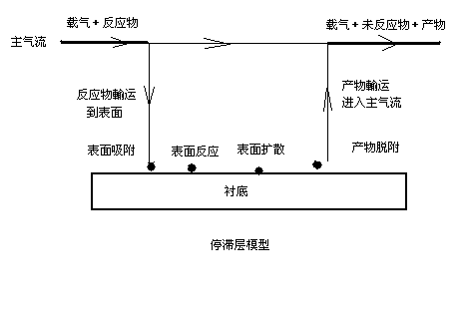

Slide 22
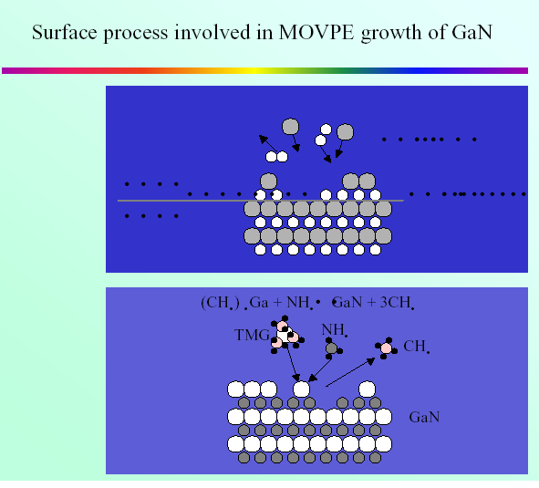

Slide 23
控制过程的特征（生长速率V）
实验参数 | 质量輸运控制 | 扩散控制 | 动力学控制
生长温度 | V ∝T^{m} ^{m<-1} | V ∝T^{m} ^{M=3/2- 2} | V ∝e^{m-ΔEα/RT}
总气流量 | 增加 | 增加 | 无关
气体流速 | 无关 | 增加 | 无关
衬底晶向 | 影响小 | 影响小 | 影响大
衬底表面积 | 无关 | 有关 | 有关
衬底位置 | 影响小 | 影响大 | 影响大

Slide 24
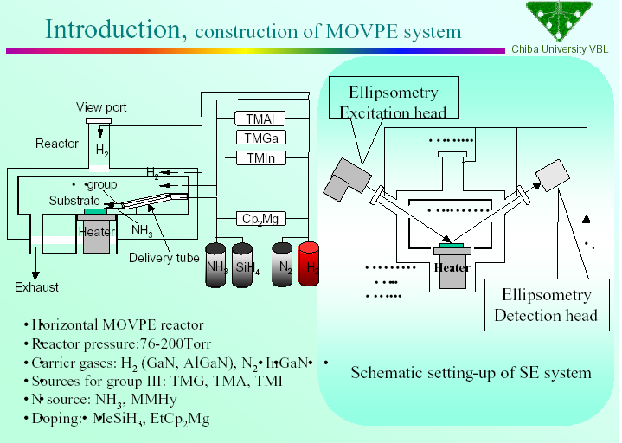
2.2.3 MOCVD 生长系统

Slide 25
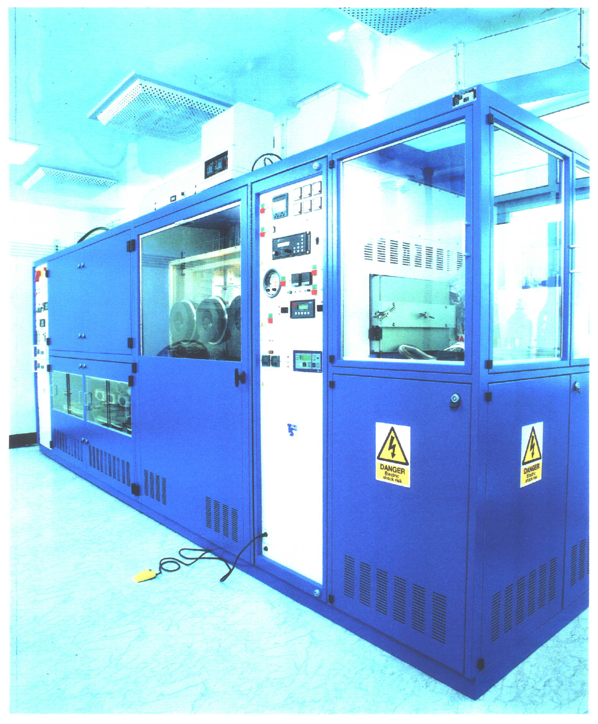
北京大学MOCVD生长系统

Slide 26
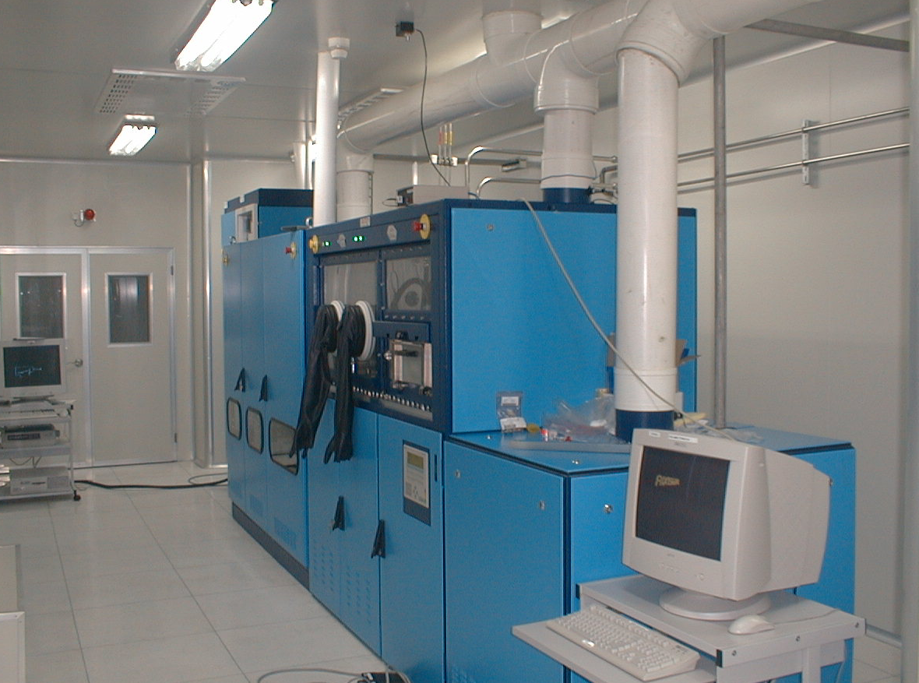

Slide 27
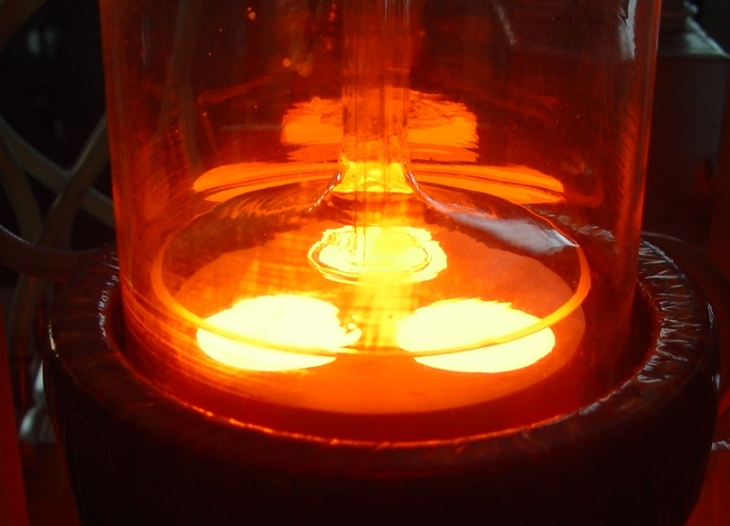
MOCVD设备反应室加热测试——1050度

Slide 28
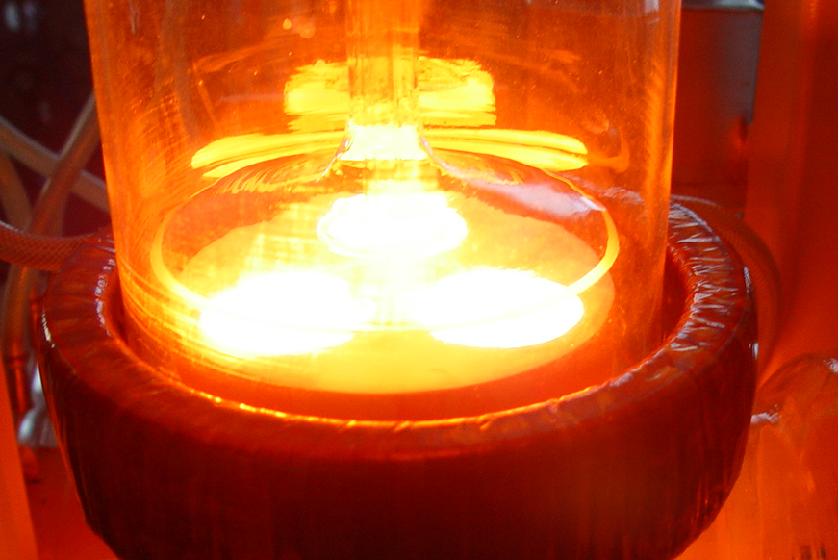
MOCVD设备反应室加热测试——1300度

Slide 29
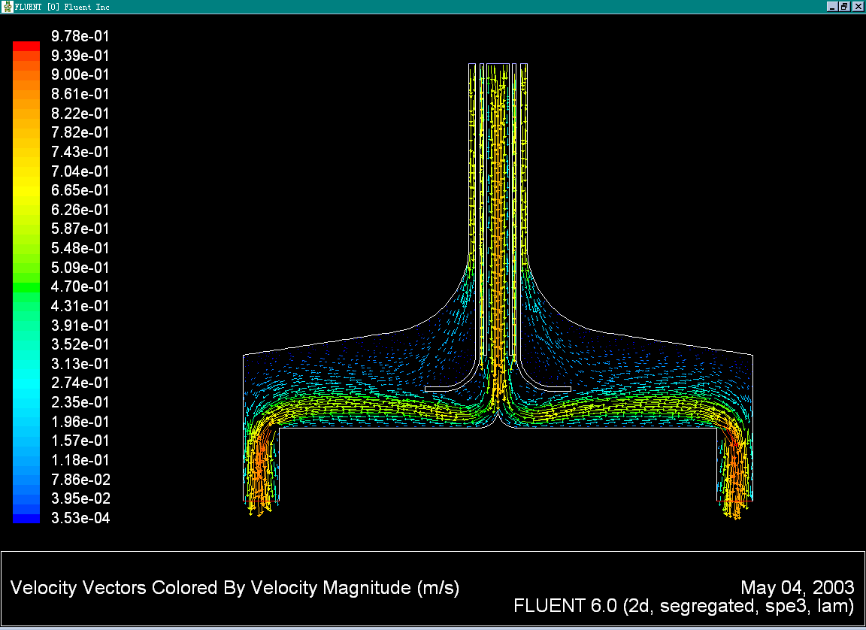
反应室内流场模拟

Slide 30
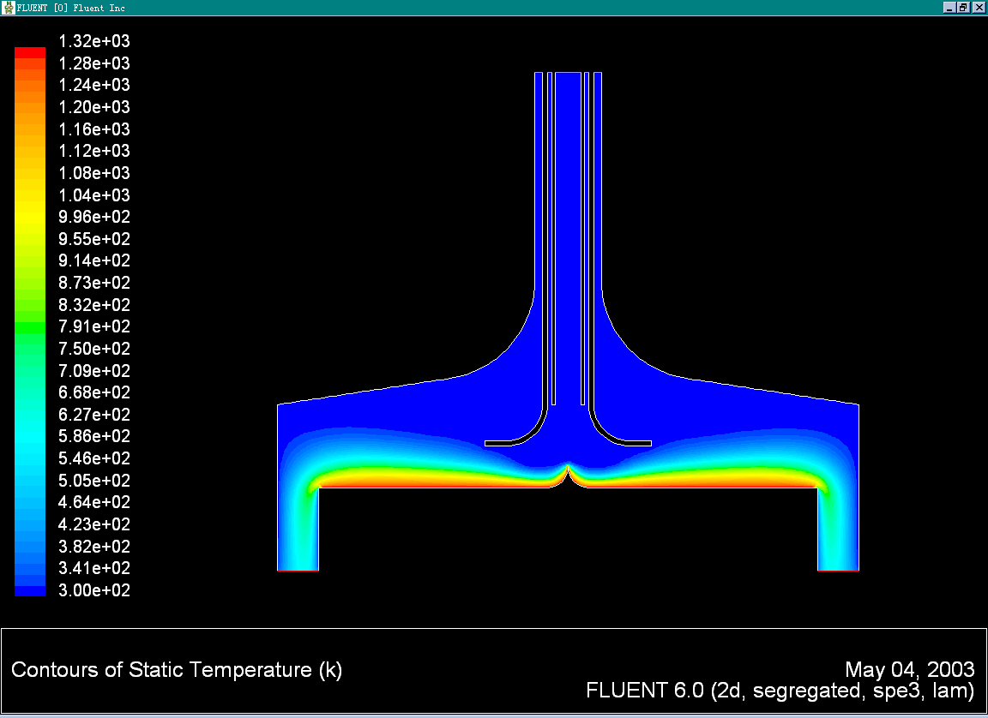
反应室内温场模拟

Slide 31
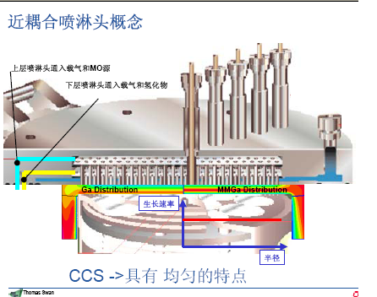
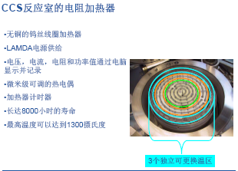
现有反应室的情况

Slide 32
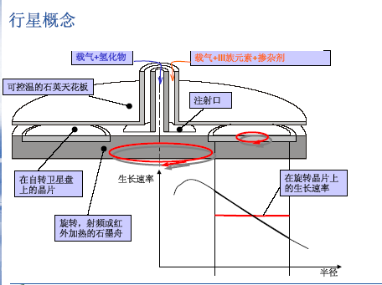
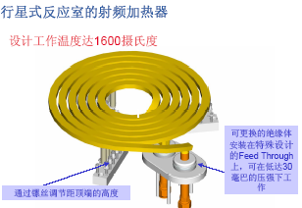
现有反应室的情况

Slide 33
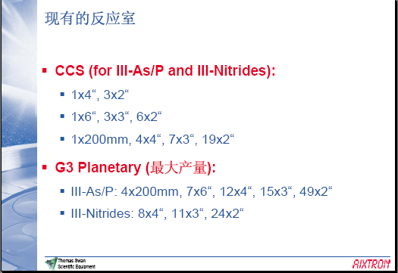
现有反应室的情况
AIX G5+ GaN/Si 8”x5

Slide 34
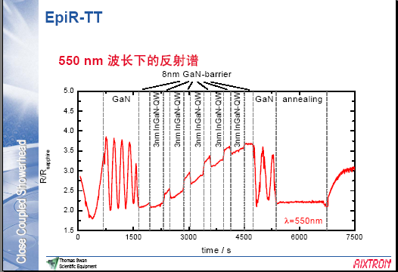
最新进展－反射谱测量EpiR-TT
波长范围：
280－750nm

Slide 35
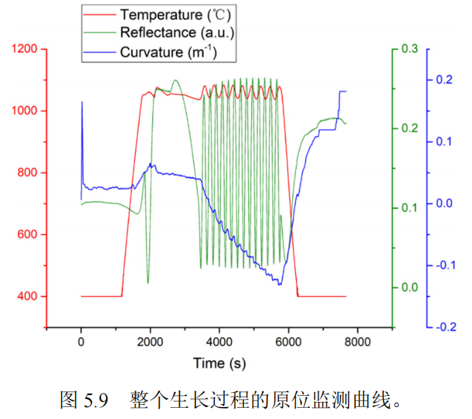
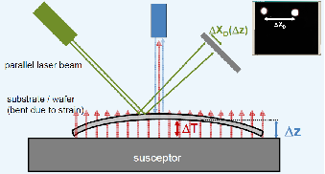

Slide 36
MOCVD原理
热力学注重所有外延生长过程，包括OMVPE，因为外延生长只不过是高度受控的相转变。因此，热力学完全决定着所有生长过程的的驱动力，进而确定最大生长速率。此外，在许多生长条件下对于外延热力学的了解，可以确定合金的组分以及固体的化学配比。尽管III/V半导体的非化学计量比很小，但是它控制着本征缺陷，如空穴、空位和反位缺陷的浓度。这将进而影响杂质的结合，包括作为掺杂剂对系统的故意掺杂以及沾污物。这也部分决定着基质材料和掺杂剂两者的扩散系数。

Slide 37
第二章 宽禁带半导体材料制备（第4－6次课）
§2.1主要制备技术 §2.2 MOCVD原理
§2.3 InGaN，AlGaN热力学模拟
§2.4 GaN基材料生长工艺
§2.5 PSS与NPSS外延 §2.6 Si上GaN生长
§2.7 低维结构外延 §2.8 本章小结

Slide 38
Epitaxial growth of wurtzite GaN and ternary compounds
Guoyi Zhang(张国义） and Yuzhen Tong（童玉珍）
Optoelectronic Properities of Semiconductors and Superlattices
III-Nitride Semiconductors: Growth. Vol. 19, p607-665 (2003)

Slide 39
MODEL AND CALCULATION PROCEDURE
GaN and related group III nitrides have been successfully grown by MOVPE using TMGa, TMIn and TMAl and ammonia as sources. To analyse AlxGa1-xN and InxGa1-xN grown by MOVPE, the following assumptions are used.
1、All gaseous species are ideal.
2、We ignore the pre-reactions between group III precursors and NH3. TMGa, TMAl and TMIn are decomposed irreversibly near the vapor-solid interface above susceptor at usual growth temperatures. Thus, we have
Ga(CH₃)₃(g)+H₂(g)=Ga(g)+3CH₄(g)……………(1)
In(CH₃)₃ (g)+H₂(g)=In(g)+3CH₄(g)………………(2)
Al(CH₃)₃(g)+H₂(g)=Al(g)+3CH₄(g)………………(3)

Slide 40
3、Without catalyst, the decomposition rate of ammonia is very low. It was found that pure quartz, graphite and GaN surfaces had a minor influence on the decomposition. In order to calculate the influence of decomposition of ammonia, we introduce a decomposed fraction of NH₃, η,
NH₃(g)=(1-η)NH₃+η/2N₂(g)+3η/2H₂(g)……………(4)

Slide 41
4、We ignore the reactions between N₂ and the group III elements in the temperature range of 500-1100ºC, since N₂ molecule has strong inert behavior.
Ternary alloys are synthesized by the reactions between NH₃ and the group III elements, and thermodynamic equilibrium established at the solid-vapor interface.
Assumptions 3 and 4 make this model a quasi-equilibrium model.

Slide 42
We select InGaN as a sample here.
The following species are chosen as the necessary vapor species in analyzing the growth of these systems: In, Ga, NH₃, H₂, N₂, Inert gas and CH₄.
The chemical reactions, which take place at the growing surface to form InGaN alloy, are
Ga(g)+NH₃=GaN(alloy)+3/2H₂……………….(5)
and
In(g)+NH₃=InN(alloy)+3/2H₂………………….(6)
where GaN(alloy) and InN(alloy) stand for the binary compounds in the In_{x}Ga_{1-x}N alloy, respectively.
The equations of mass action for reaction (5) and (6) are as follows:
质量作用方程

Slide 43
The equations of mass action for reaction (5) and (6) are as follows:
…………………(7)
…………………(8)
Where Pi is the equilibrium partial pressure of species i-th, P_{tot} is the total pressure, K_{i} is the equilibrium constant of the reaction i-th and
are the activities of the solid GaN and InN in InGaN alloy, respectively.
The activities in eqs. (7) and (8) were determined from the regular solution model as follows:
可逆化学反应达到平衡时，每个产物浓度系数次幂的连乘积与每个反应物浓度系数次幂的连乘积成正比，这个比值叫做平衡常数。反应进行得越完全，平衡常数就越大。

Slide 44
…………..(9)
…………..(10)
where Ω is the interaction parameter of InxGa1-xN which was taken as 7280 cal/mole, and x is the mole fraction in InxGa1-x N alloy.

Slide 45
Usually partial pressures are used to express the mass conservation constraints of the elements, since the change of the total number of molecules created by the reactions is very small.
However, in the MOVPE growth of III- nitrides, the change of the total number of molecules created by the reactions, mainly by the decomposition of ammonia, can not be neglected.
In this case, instead of using partial pressures to describe the MOVPE growth of III- nitrides, we use number of moles to express the mass conservation constraints of element N, H, In and Ga:
………….(11)
where nº_{i} is input number of moles of species of i-th, and are molar quantities of GaN and InN, respectively, in the alloy.

Slide 46
..…………………(12)
…………….…………………(13)
..……………………………(14)
where n_{In} and n_{Ga} are number of moles of indium and gallium in gas phase, respectively.
The partial pressure of species i can be obtained as follows:
..……………………………(15)
where n_{tot} is the total number of moles in the gas phase,
……………(16)
where n _{IG} is the number of moles of inert gas.

Slide 47
The total pressure of the reactor is expressed as follows:
…………(17)
Where P_{IG} is the partial pressure of inert gas, In order to describe the effect of composition in H₂-inert mixed carrier gas, a parameter f is introduced:
..……………………………(18)
The x value can be expressed as (on stoichiometry conservation constrains)
..……………………………(19)

Slide 48
In addition, the input V/III ratio, R, has been introduced:
..……………………………(20)
The calculations performed by solving eqs. 7-20.
The equilibrium partial pressures in the gas phase and the distribution coefficient can be obtained for a given set of growth temperature, reactor pressure, R , f , x and .

Slide 49
RESULTS AND DISCUSSION
Figure 1 (a) shows that the calculated activities of AlN and GaN in Al_{x}Ga_{1-x}N. In Al_{x}Ga_{1-x}N the calculated activities of AlN and GaN deviate slightly from the ideal solution and the deviation changes weakly with temperature. The interaction parameter used is 672 cal/mole, because the lattice constant of AlN is close to that of GaN. The Al_{x}Ga_{1-x}N alloy can form a solid solution over the entire composition.
Fig. (1a)
According to Eqs. (9),(10)

Slide 50
Figure 1 (b) shows that the calculated activities of InN and GaN in In_{x}Ga_{1-x}N.
In In_{x}Ga_{1-x}N, however, the calculated activities of InN and GaN in InxGa1-xN deviates strongly from the ideal solution.
In addition, the deviation changes strongly with temperature.
Furthermore, In_{x}Ga_{1-x}N alloy is an immiscible III-V alloy.
550ºC
Fig. 1(b)

Slide 51
Fig. 2 (a) shows the equilibrium partial pressure of gaseous species over AlxGa1-xN alloys.
The equilibrium partial pressures of Ga and Al change with the solid composition.
The dotted lines show the vapor pressure of pure metal Al and Ga, Pº_{Al} and Pº_{Ga}, respectively.
It can be seen that the equilibrium partial pressure of Al is significantly lower than that of Ga, which lead to the preferential Al incorporation into the Al_{x}Ga_{1-x}N alloy.
It is worth while to point out that the equilibrium partial pressures of Ga or Al are smaller than the vapor pressure of Ga or Al. So that there is no Ga or Al droplets deposited on the substrate under most commonly used growth conditions.
1
0
1
1
0
0
H
2
1
0
-
1
N
H
3
1
0
-
2
N
1
0
-
3
2
1
0
-
4
C
H
4
1
0
-
5
P
o
partial pressure (atm)
1
0
-
6
G
a
1
0
-
7
P
o
)
A
l
G
a
m
1
0
-
8
t
a
1
0
-
9
(
e
1
0
-
1
0
r
u
1
0
-
1
1
s
s
1
0
-
1
2
e
r
1
0
-
1
3
p
l
1
0
-
1
4
a
i
t
r
1
0
-
1
5
a
P
1
0
-
1
6
A
l
1
0
-
1
7
1
0
-
1
8
1
0
-
1
9
1
0
-
2
0
0
.
0
0
.
2
0
.
4
0
.
6
0
.
8
1
.
0
X
i
n
A
l
x
G
a
1
-
x
N
Fig. 2(a)

Slide 52
Fig. 2 (b) shows the equilibrium partial pressure of gaseous species over InxGa1-xN alloys at 750 ºC.
For comparison, the dotted lines show the vapor pressure of pure In and Ga metal, Pº_{In} and Pº_{Ga}, respectively.
The general features of the equilibrium partial pressures are similar to that of Al_{x}Ga_{1-x}N (see Fig. 2 (a)), except the partial pressure of In is quite high even very close to the vapor pressure of pure In.
Fig. 2(b)

Slide 53
Fig.3 (a) shows the theoretical curves of Al_{x}Ga_{1-x}N solid composition at different growth temperatures as a function of the input mole ratio of [TMAl]/[TMAl+TMGa].
At higher temperature (>1000 ºC), Al shows a stronger tendency of incorporating into the solid phase than that of Ga.
This result is also confirmed by a much higher partial pressure of Ga than that of Al in the gaseous phase at elevated temperature shown in Figure 2 (a).
The equilibrium partial pressure of Ga decreases with the growth temperature. At 900 ºC the partial pressure of Ga is low enough that the calculated solid composition shows an almost linear dependence on the input mole ratio of the group III metalorganic sources.
Fig.3 (a)

Slide 54
Fig.3 (b) shows theoretical curves of the In_{x}Ga_{1-x}N solid composition as a function of the input mole ratio of the group III metalorganic compounds, varying the growth temperature from 500 to 800 ºC.
The solid composition is a linear function of the input mole fraction ratio at 500 to 600ºC. However, with the increase of growth temperature, the solid composition deviates from the linear function dramatically.
It is interesting that at lower temperature (<780 ºC for example), we are able to grow metastable In_{x}Ga_{1-x}N alloys throughout the entire range of solid composition. It can be seen that the solid-vapor distribution function curve becomes an “S” shape one when the growth temperature is higher than 780 ºC
Fig. 3(b)

Slide 55
Fig. 4 (a) shows the theoretical curves of the Al_{x}Ga_{1-x}N as a function of input mole ratio of the group III metalorganic compounds. The reactor pressure varies from 0.1 to 2 atm. A linear function of solid composition with the input [TMAl]/[TMAl+TMGa] ratio can be obtained when the reactor pressure is equal to or less than 0.1 atmospheric.
Fig. 4(a)

Slide 56
Fig. 4 (b) shows the theoretical curves of In_{x}Ga_{1-x}N solid composition as a function of the input mole ratio of the group III metalorganic compounds, varying the reactor pressure from 0.1 to 1 atmospheric.
Comparing with the AlGaN system the effect of reactor pressure on the solid composition is very strong.
The solid composition deviates from the linear function with the increase of P_{tot}.
The use of low pressure is favorable for the growth of InGaN.
Fig. 4(b)

Slide 57
Fig. 5 (a) shows the theoretical curves of Al_{x}Ga_{1-x}N as a function of the input mole ratio of group III metalorganic compounds.
The hydrogen fraction in a H₂-IG mixture carrier gas varies from 0.01 and 1.
Fig. 5 (a)

Slide 58
Fig. 5 (b) shows the theoretical curves of the In_{x}Ga_{1-x}N solid composition as a function of the input mole ratio of the group III metalorganic compounds, varying the hydrogen fraction in carrier gas of 0.01 and 1.
The predicted solid composition deviates from the linear function with the increasing of the hydrogen fraction in carrier gas.
The increase of partial pressure of H₂ drives the reaction to the left and therefore less indium will be incorporate into the solid phase. The use of inert gas or nitrogen as a carrier gas is very important for the growth of InGaN alloy. In the AlGaN system, however, the use of inert gas or nitrogen is not important.
Fig. 5(b)

Slide 59
In Fig. 6 (a), the solid composition of AlGaN deviates from the linear function if η increases, since we assume that III-nitrides are synthesised by the reactions between III elements and undecomposed ammonia.
The influence of η on the AlxGa1-xN system, however, is smaller as compared with the InGaN system.
decomposed fraction of NH₃, η,
Fig. 6(a)

Slide 60
Fig. 6 (b) shows the theoretical curves of the In_{x}Ga_{1-x}N solid composition as a function of the input mole ratio of the group III metalorganic compounds, varying the decomposition fraction of ammonia, η, of 0 and 0.5.
The η has a dramatic inference on the incorporation of In.
For example in Fig. 6 (b) the solid composition is a linear function of the input mole ratio at η=0.0.
However, with the increase of η, the solid composition deviates from the linear function and the indium content in the solid becomes about 0.1 for the input mole ratio of 0.72 at η=0.5.
Fig. 6(b)

